Slide 1

Customer Profiles
TM195
TM498
TM798
Observations & Recommendations

Slide 2
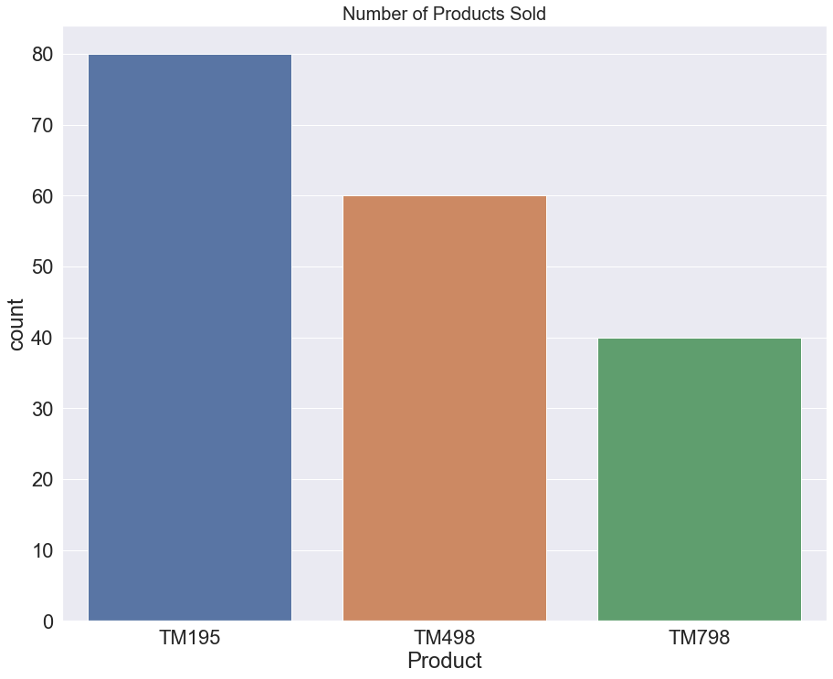
Product Information: QUANTITY SOLD
Product TM195
is our best seller:
• 80 units sold
Product TM498 comes in second:
• 60 units sold
Product TM798 sells the least:
• 40 units sold

Slide 3
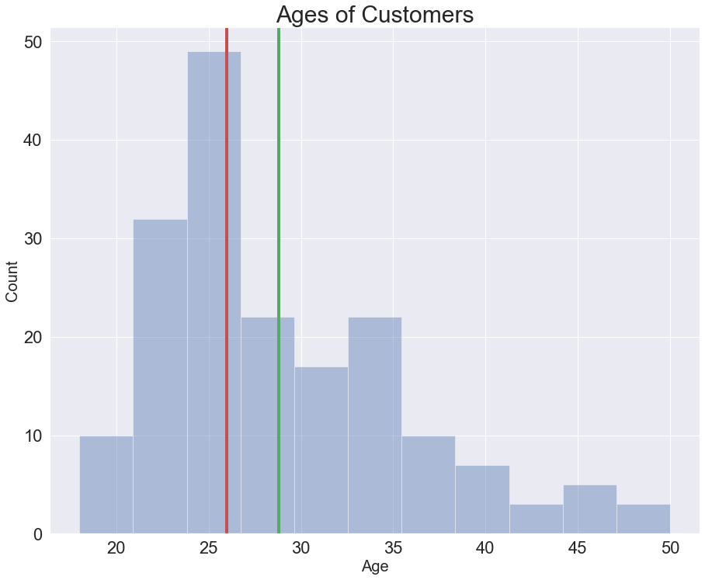
Customer Demographics: AGE
The majority of our customers are between 20 and 30 years old.
Ages range between 18 and 50.
Average age = 28.8
Median age = 26

Slide 4
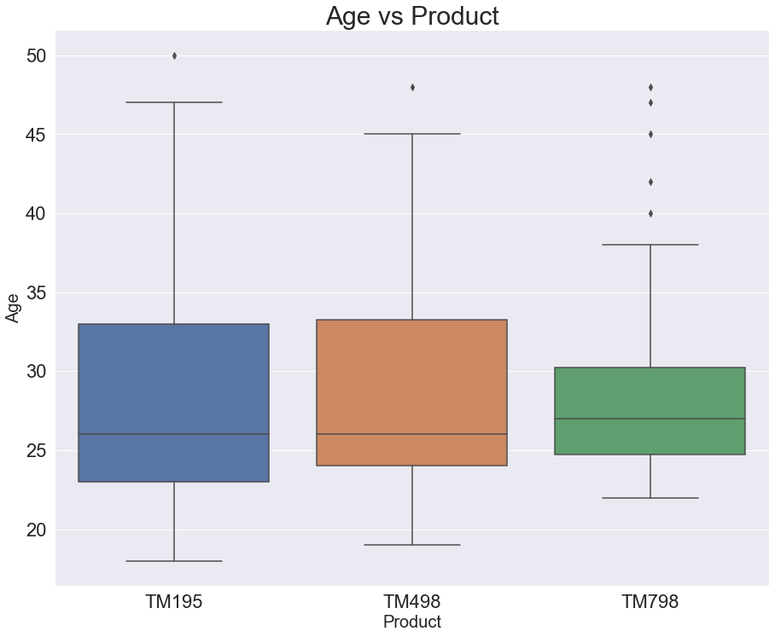
Product Information: AGE
Product TM195
Range: 18 to 50 years
Target: 23 to 33 years
Product TM498 Range: 19 to 48 years
Target: 24 to 33 years
Product TM798 Range: 22 to 48 years
Target: 25 to 30 years

Slide 5
Conclusions: AGE
Our three products have somewhat similar age demographics.
Older customers (>35) and younger customers (<22) tend to prefer TM195 and TM498.
Customers who prefer TM798 tend to be between 25-30 years old.

Slide 6
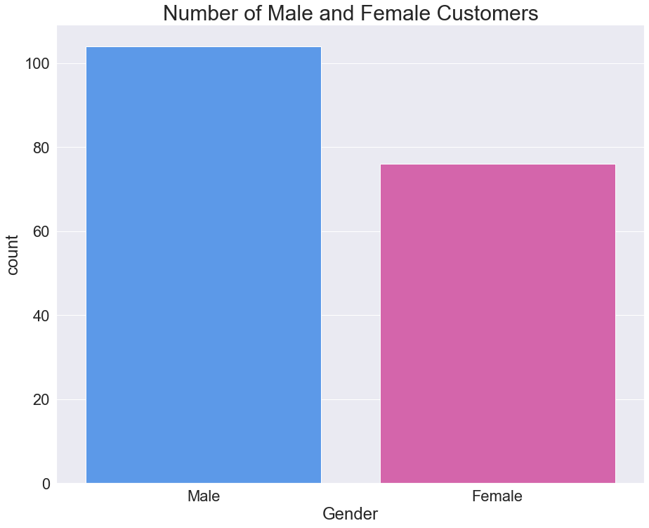
Customer Demographics: GENDER
The majority of our customers are male.
104 males
(58%)
76 females
(42%)

Slide 7
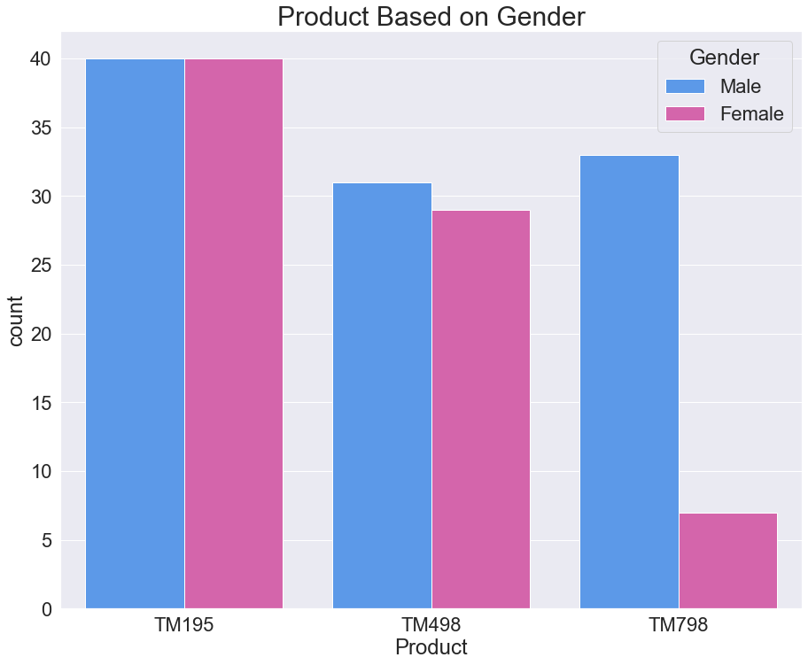
Product Information: GENDER
Males are slightly more likely to buy a TM798 than a TM498. But overall, males prefer the TM195.
Females also prefer the TM195. The TM498 is somewhat less popular with females. Very few females are interested in the TM798.

Slide 8
Conclusions: GENDER & AGE
Males and females are approximately equally likely to purchase the TM195.
Females are far less likely to purchase the TM798.
TM195 and TM498 have broad appeal
• Purchased by males and females
• Older customers are more likely to purchase these
TM798 purchases have mostly been made by males in their late twenties.

Slide 9
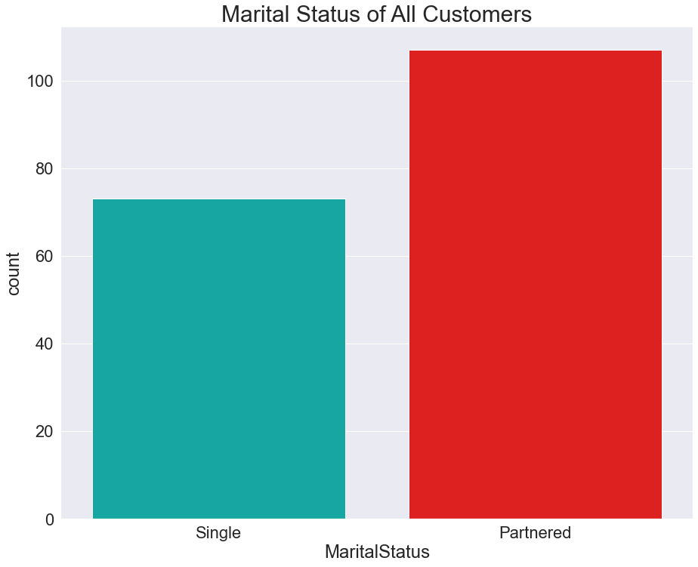
Customer Demographics: MARITAL STATUS
The majority of our customers have a partner.
73 single
(41%)
107 partnered
(59%)

Slide 10
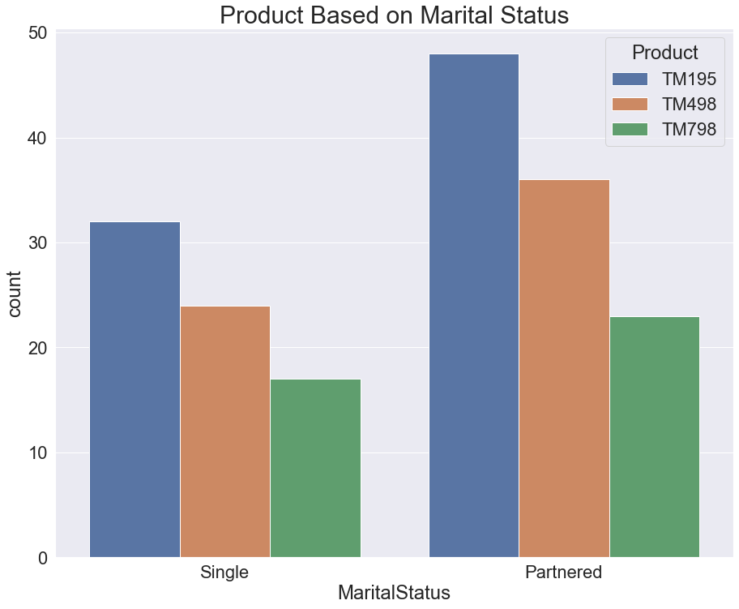
Product Information: MARITAL STATUS
Regardless of marital status, the preference for our products is:
1) TM195
2) TM498
3) TM798

Slide 11
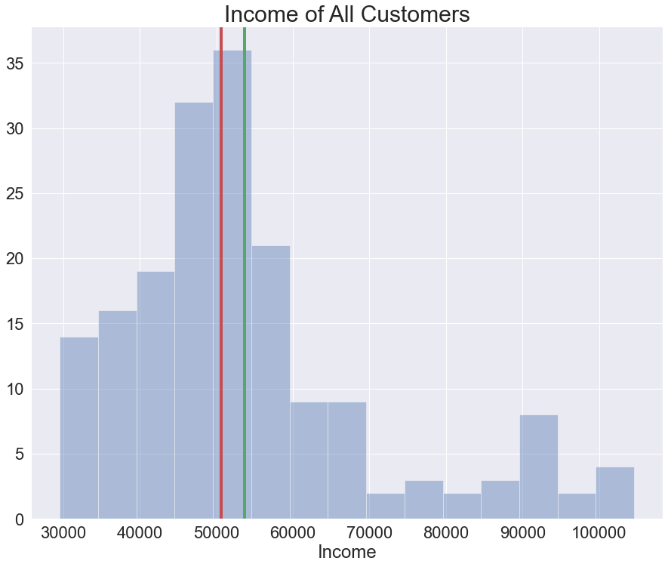
Customer Demographics: INCOME
The majority of our customers make less than $60,000 per year.
Incomes range between approximately $30,000 and $105,000.
Average income = $53K
Median income = $51K

Slide 12
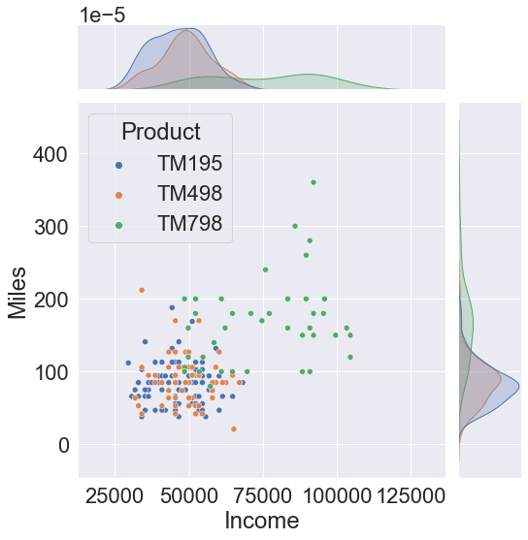
Product Information: INCOME & MILES
Customers who purchased the TM195 or TM498 make less than $70,000 per year and run less than 200 miles.
Customers who purchased the TM798 make more than $50,000 per year and run more than 100 miles.

Slide 13
Conclusions: INCOME
The higher a customer’s income, the more likely they are to purchase a TM798.
Customers with lower income are approximately equally likely to purchase a TM195 or a TM498.

Slide 14
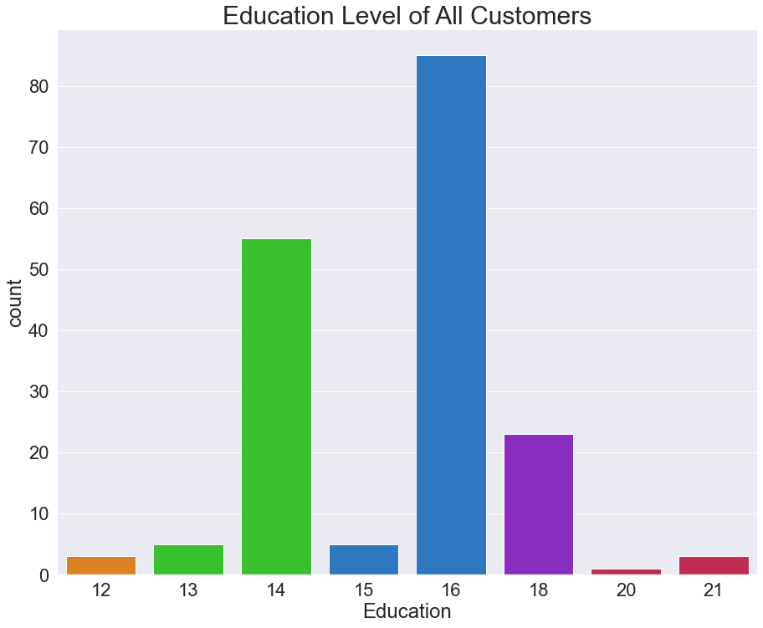
Customer Demographics: EDUCATION
High School: 1.7%
Associate’s: 33.3%
Bachelor’s: 50%
Master’s: 12.8%
Doctorate: 2.2%
12 years of education
13-14 years of education
15-16 years of education
17-18 years of education
19+ years of education

Slide 15
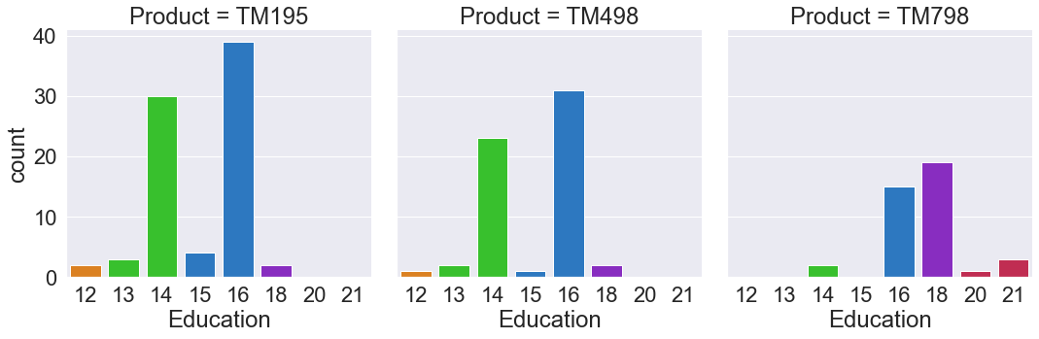
Product Information: EDUCATION
Most customers who purchased a TM195 or TM498 have an Associate’s degree or a Bachelor’s degree.
Most customers who purchased a TM798 have a Bachelor’s degree or a Master’s degree.

Slide 16
Conclusions: EDUCATION
Customers with more years of education are more likely to purchase a TM798.
Customers with less years of education are more likely to purchase a TM195 or a TM498.

Slide 17
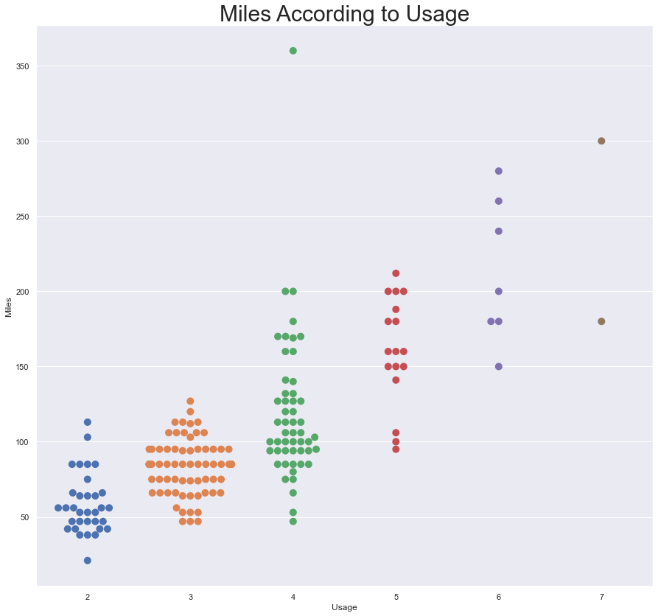
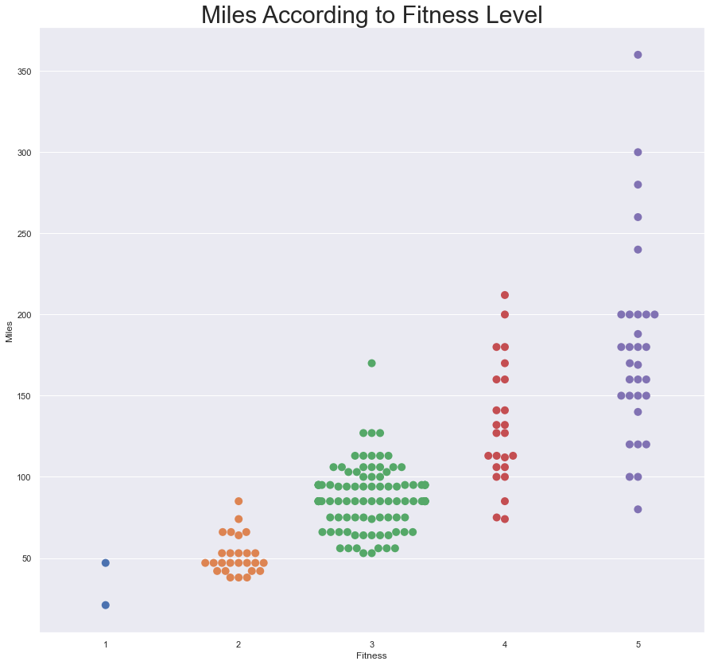
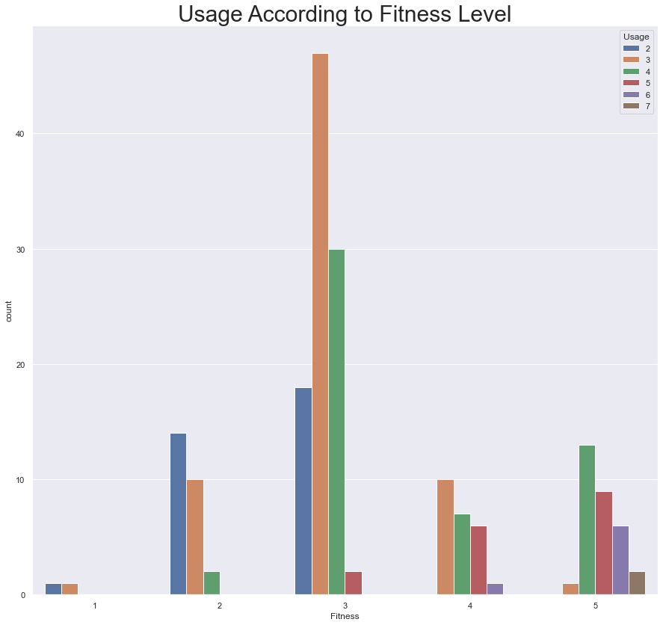
Customer Demographics: MILES -vs- USAGE -vs- FITNESS
The more times per week a customer uses the treadmill, the more miles they will run.
The higher a customer’s fitness rating, the more miles they will run.
The higher a customer's fitness level, the more they will use the treadmill.

Slide 18
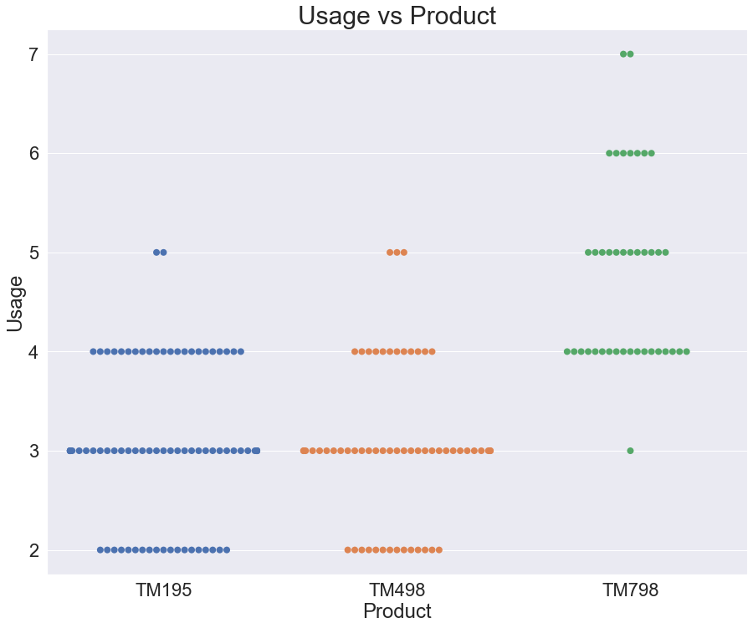
Product Information: USAGE
Most customers who bought a TM195 use it 2-4 times per week.
Most customers who bought a TM498 use it 2-4 times per week.
Most customers who bought a TM798 use it 4 or more times per week.

Slide 19
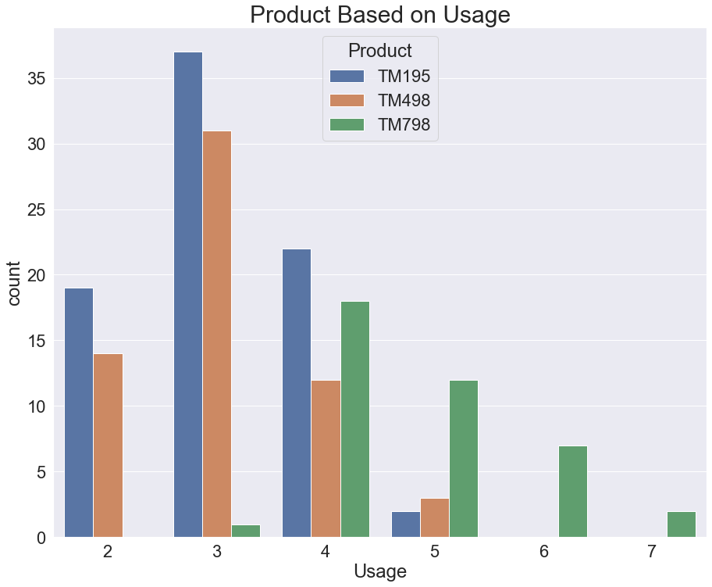
Product Information: USAGE
The TM195 is purchased most by people who use it 4 times per week or less.
The TM498 is purchased most by people who use it 4 times per week or less.
The TM798 is purchased most by people who use it 4 times per week or more.

Slide 20
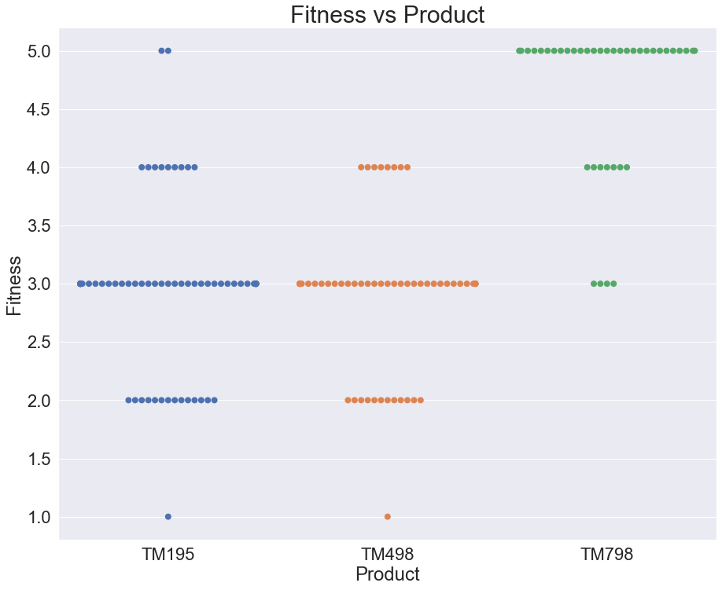
Product Information: FITNESS
The TM195 and TM498 appeal to people of each fitness level quite equally. They appeal most to people of an average fitness level.
The TM798 appeals most to people with higher fitness levels.

Slide 21
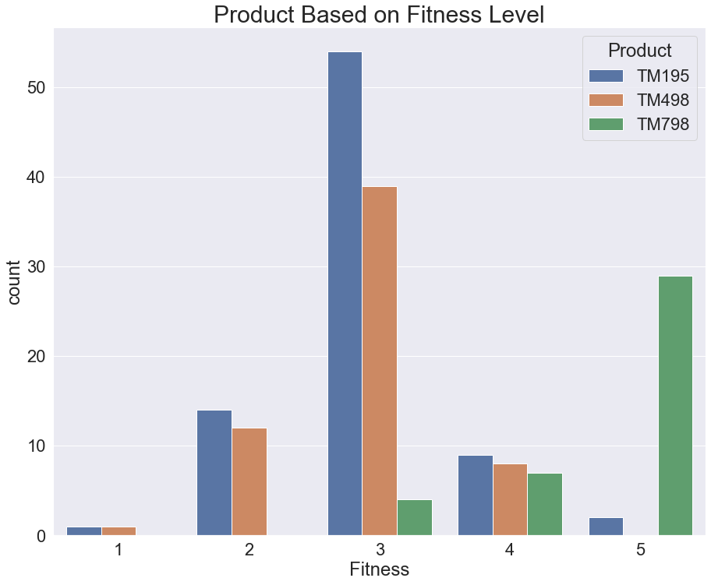
Product Information: FITNESS
Customers with a fitness level of 3 or less are most likely to buy a TM195 or a TM498.
Customers with a fitness level of 4 are approximately equally likely to buy any of the three products.
Customers with a fitness level of 5 buy the TM798 almost exclusively.

Slide 22
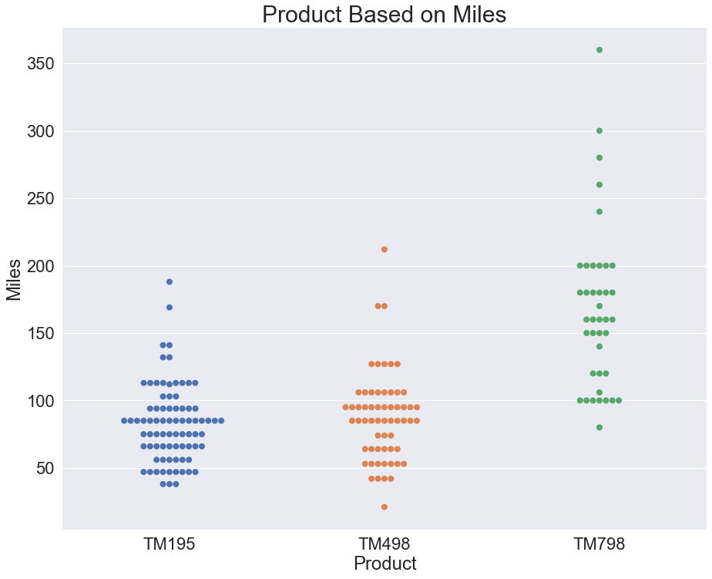
Product Information: MILES
Customers who purchased the TM195 or the TM498 tend to run between 50-110 miles.
Customers who purchased the TM798 tend to run between 100-200 miles.

Slide 23
Conclusions: FITNESS, USAGE, & MILES
Customers are more likely to purchase a TM798 if they have higher fitness levels, use the product more often, or run more miles.
Customers more likely to purchase a TM195 or a TM498 if they have lower fitness levels, use the product less often, or run fewer miles.

Slide 24
Customer Profile: TM195 & TM498
Model TM195 and model TM498 appeal to the same group of customers. The most defining characteristic of customers who purchased these models are:
• Lower fitness level (3 or less)
• Lower usage (4 or less)
• Lower miles (125 or less)
• Lower income ($70,000 or less)
• Lower education (Bachelor’s or less)

Slide 25
Customer Profile: TM798
The most defining characteristic of customers who purchased TM798 are:
• Higher fitness level (3 or more)
• Higher usage (4 or more)
• Higher miles (100 or less)
• Higher income ($50,000 or more)
• Higher education (Bachelor’s or more)

Slide 26
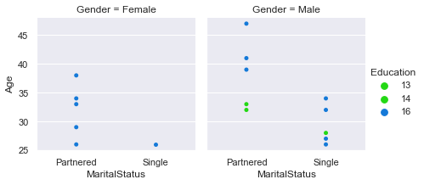
Room for Growth: TM195 & TM498 -vs- TM798
Model TM195 and model TM498 are our best sellers, whereas TM798 lags behind.
Some customers who fit the TM798 profile purchase the TM195 or TM498 instead.
We may see growth
in the sales of TM798
if we target certain
groups of customers:
Associate’s
Bachelor’s

Slide 27
Room for Growth: TM195 & TM498 -vs- TM798
Customer who purchased a TM195 or TM498 but have a fitness level of 3 or greater, use the machine 4 or more times per week, and have an income of $50,000 or more tend to be:
• Females between
25 and 40 years old
with a Bachelor’s
degree and a partner
• Males between 25
and 45 years old with
a Bachelor’s or
Associate’s degree
(partnered or single)
Associate’s
Bachelor’s

Slide 28
Extra Customer Profile: TM798
Consider advertising the TM798 to the follow types of customers to boost sales:
• Gender: female
• Age: 25-40
• Marital Status: partnered
• Education: 15+ years
• Income: $50,000+
• Fitness level: 3+
• Usage: 4+ days/week
• Gender: male
• Age: 25-45
• Marital Status: n/a
• Education: 13+ years
• Income: $50,000+
• Fitness level: 3+
• Usage: 4+ days/week

